Slide 1
GENDER CLASSFICATION MODEL
By :
Name :M.Agnes Godwin
Degree :B.E
Branch :CSE
College :PET Engineering college
NM ID :au963221104004
Email Id :godwinrasal@gmail.com

Slide 2
outline
Introduction
Related work
Deep learning
Material and methods
Conclusion
references

Slide 3
Indroduction
Gender classification is to determine a person's gender, e.g., male or female, based on his or her biometric cues.
Usually facial images are used to extract features and then a classifier is applied to the We contend that, at the intersection of these two axes,
four main models of gender recognition can be identified:
ascriptive binary, ascriptive nonbinary, elective binary, and elective nonbinaryextracted features to learn a gender recognizer. n recent years, researchers’ interest in visual surveillance applications has been growing due to the availability of low-cost optical and infrared cameras and advanced computing machines.
Digital cameras are widely used nowadays and deployed on roads, in shopping malls, metro lines and train stations, airports, and residential areas. With digital cameras, pedestrian images are captured under a specific field of view (FoV) in controlled environments [. These days, object recognition from images and videos captured by digital cameras is being preferred by people for automated tasks related to security monitoring, public safety , pedestrian behavior analysis, etc. Different approaches for video object detection based on deep learning were studied in

Slide 4
Related work
In this section, a summary of methods that use hand-crafted features for gender classification is highlighted. These approaches use low-level information (features related to shape, color, texture, etc.). For instance, Cao et al.
[42] proposed an algorithm named part-based gender recognition (PBGR) utilizing fixed frontal or back views of gender full-body appearance to obtain edge map-based shape information, HOGs, and raw information. They achieved 76.0%, 74.6%, and 75.0% accuracy on front views, back views, and non-fixed views,
respectively. Furthermore, Guo et al. [43] utilized front views, back views, and mixed views to investigate biologically inspired features (BIF) from the human body to handle pose variations with support vector machine (SVM). For manifold learning, unsupervised principal component analysis (PCA), supervised orthogonal locality preserving projections (OLPP), marginal
Fisher analysis (MFA), and locality-sensitive discriminant analysis (LSDA) were utilized. They achieved 79.5%, 84.0%, and 79.2% accuracy on frontal view with BIF+LSDA, back view with BIF+LSDA, and mixed views with BIF+PCA, respectively, on MIT dataset.

Slide 5
Deep learning
To cope with the problems raised by the traditional hand-crafted feature-based gender classification techniques discussed above such as pedestrians’ diverse appearances and captured images having a low resolution,
deep CNN models have been proposed and are considered more appropriate [46,47]. The CNN architecture is popular because of its significant advances in the accuracy obtained in different classification studies [48,49,50].
Currently, trained deep CNN models have been used in a few existing methods for gender prediction. For instance, Ng et al. [16] utilized a CNN model comprising seven layers for issues related to the domain of gender classification.
training of CNN model was carried out on MIT pedestrian dataset for the prediction of gender classification. Overall accuracies of 80.4% and 79.2% were obtained on both front and rear views with a view classifier and without a view classifier, respectively.
The proposed approach performed successfully on homogeneous datasets of a small size. Antipov et al. [17] applied mini-CNN and AlexNet-CNN to learn features and compare them with hand-crafted features (HOG) to solve the issue of image feature selection

Slide 6
Material and methods
This section presents the proposed model 4-BSMAB and its major steps for PGC. These steps include pre-training of proposed model, dataset balancing, process of feature extraction from 4-BSMAB model, ACS-based feature optimization, and, at the end, classification. An overview of this model is A new architecture
, 4-BSMAB (4-branch subnets with modified AlexNet backbone), based on CNN architecture is introduced in this work for PGC. This newly developed model is derived from CNN network named AlexNet [54]. AlexNet contains 25 layers including 5 convolutional layers, 3 fully connected layers, 3 pooling layers, 7 rectified linear unit (ReLU) layers, 2 dropout layers, and SoftMax layers and is divided into 3 repeating blocks named here as R1, R2, and R3.
The new model contains 64 layers including input and output layers. The architectural view of proposed model 4-BSMAB is presented in Figure 2, and the details of layers are listed in Table 1.
presented in Figure 1. These steps are elaborated in the upcoming section.

Slide 7
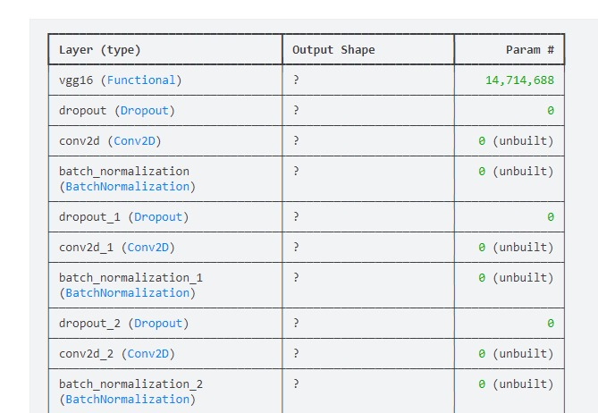
Result:

Slide 8
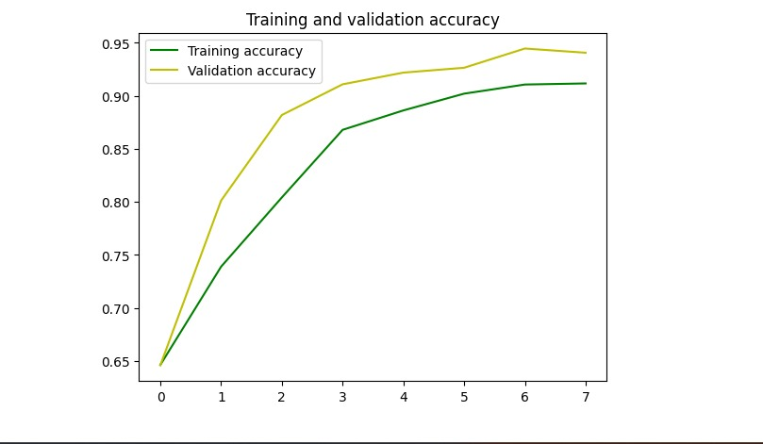
Result –count:

Slide 9
conclusion
A novel CNN-based framework, 4-BSMAB, was assessed for feature extraction, and ACS was used for the selection of optimized feature sets. The SoftMax classifier was utilized to train 4-BSMAB model on the existing CIFAR-100 dataset, and features were obtained from common pedestrian datasets.
An optimized feature set obtained with ACS optimization technique was provided to various classifiers of SVM and KNN for PGC. Five-fold-type cross-validation was carried out to train and test the pedestrian datasets. Extensive experimentation was carried out with various feature subsets, and the details of only five experiments conducted on each dataset were mentioned. It was observed from the experimentation
results that the optimized feature subset with 100 features produced a lower accuracy of 81.3%, whereas 1000-featuresubset performed better and achieved 85.4% accuracy with FKNN classifier, and 92% AUC with CSVM classifier, on MIT dataset. A comparison of the results of proposed model and existing state-of-the-art methods on MIT dataset was presented, and it was observed that the proposed method outperformed existing gender classification approaches. It was also noted that CSVM classifier performed better on PKU-Reid dataset and generated 93% accuracy and 96% AUC. The experimentation results also show that most of the classifiers produced better results with 1000-optimized feature subset and obtained second best results with an optimized feature subset of 100 features.
As per findings, results on PKU-Reid are not available in the relevant literature, and a performance comparison in this regard is not possible. Although the proposed framework produced satisfactory results, the accuracy can still be improved further. In future work, other approaches such as LSTMs, manifold learning, and quantum deep learning may be explored for better performance.

Slide 10
references:
Sivabalakrishnan, M.; Menaka, R.; Jeeva, S. Smart video surveillance systems and identification of human behavior analysis. In Countering Cyber Attacks and Preserving the Integrity and Availability of Critical Systems; IGI Global: Philadelphia, PA, USA, 2019; pp. 64–97. [Google Scholar]
Filonenko, A.; Jo, K.-H. Unattended object identification for intelligent surveillance systems using sequence of dual background difference. IEEE Trans. Ind. Inform. 2016, 12, 2247–2255. [Google Scholar]
Zhu, H.; Wei, H.; Li, B.; Yuan, X.; Kehtarnavaz, N. A Review of Video Object Detection: Datasets, Metrics and Methods. Appl. Sci. 2020, 10, 7834. [Google Scholar] [CrossRef]
Jang, D.-H.; Kwon, K.-S.; Kim, J.-K.; Yang, K.-Y.; Kim, J.-B. Dog Identification Method Based on Muzzle Pattern Image. Appl. Sci. 2020, 10, 8994. [Google Scholar] [CrossRef]
Rybak, Ł.; Dudczyk, J. A geometrical divide of data particle in gravitational classification of moons and circles data sets. Entropy 2020, 22, 1088. [Google Scholar] [CrossRef]
Rybak, Ł.; Dudczyk, J. Variant of Data Particle Geometrical Divide for Imbalanced Data Sets Classification by the Example of Occupancy Detection. Appl. Sci. 2021, 11, 4970. [Google Scholar] [CrossRef]

